Slide 1

Topic 5.5 – Developing Frontend for the DApp
Notes:
“Operating Systems: Internal and Design Principles”, 8/e, Global Edition by William Stallings, Chapter 5 “Concurrency: Mutual Exclusion and Synchronization”.

Slide 2
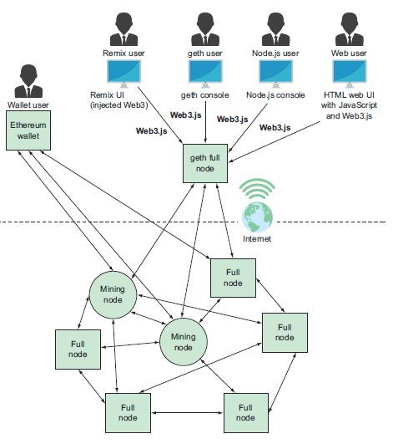
What is “frontend”
Front-end
Back-end
Notes:
At first glance, it may seem that interleaving and overlapping represent fundamentally different modes of execution and present different problems. In fact, both techniques can be viewed as examples of concurrent processing, and both present the same problems. In the case of a uniprocessor, the problems stem from a basic characteristic of multiprogramming systems: The relative speed of execution of processes cannot be predicted. It depends on the activities of other processes, the way in which the OS handles interrupts, and the scheduling policies of the OS.

Slide 3
What is “frontend”
Software developers
Typical user
Interaction enablers
Notes:
At first glance, it may seem that interleaving and overlapping represent fundamentally different modes of execution and present different problems. In fact, both techniques can be viewed as examples of concurrent processing, and both present the same problems. In the case of a uniprocessor, the problems stem from a basic characteristic of multiprogramming systems: The relative speed of execution of processes cannot be predicted. It depends on the activities of other processes, the way in which the OS handles interrupts, and the scheduling policies of the OS.

Slide 4
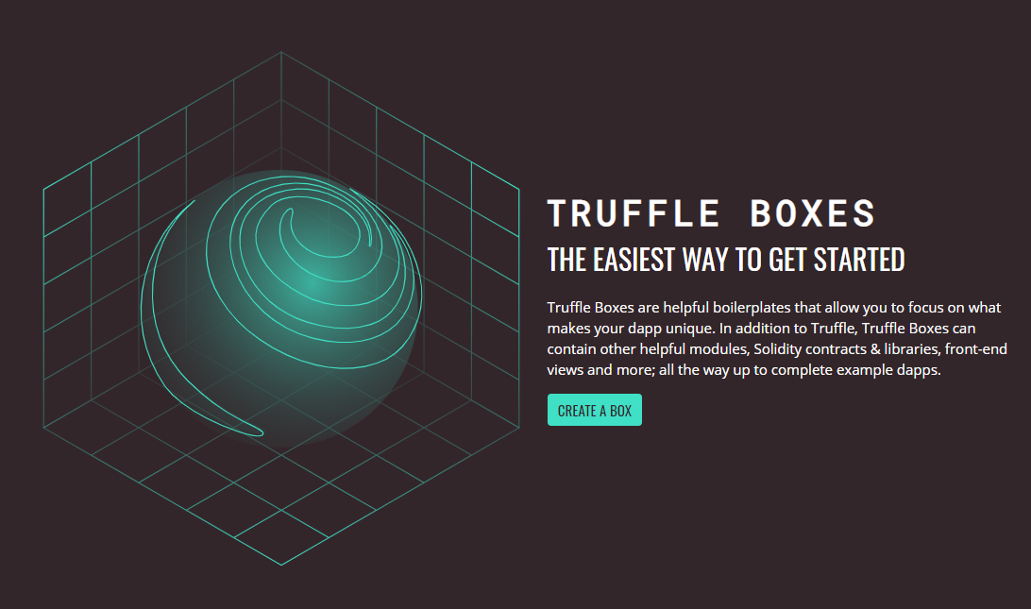
Truffle boxes/boilerplates
https://www.trufflesuite.com/boxes
Notes:
At first glance, it may seem that interleaving and overlapping represent fundamentally different modes of execution and present different problems. In fact, both techniques can be viewed as examples of concurrent processing, and both present the same problems. In the case of a uniprocessor, the problems stem from a basic characteristic of multiprogramming systems: The relative speed of execution of processes cannot be predicted. It depends on the activities of other processes, the way in which the OS handles interrupts, and the scheduling policies of the OS.

Slide 5

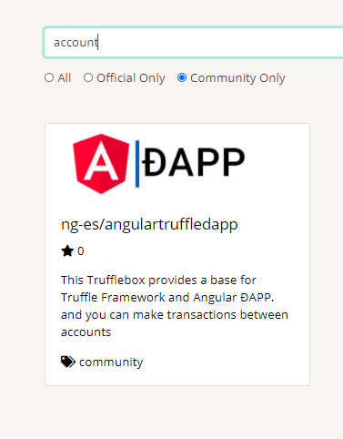
Example of a dApp truffle box
https://www.trufflesuite.com/tutorials/pet-shop
Notes:
At first glance, it may seem that interleaving and overlapping represent fundamentally different modes of execution and present different problems. In fact, both techniques can be viewed as examples of concurrent processing, and both present the same problems. In the case of a uniprocessor, the problems stem from a basic characteristic of multiprogramming systems: The relative speed of execution of processes cannot be predicted. It depends on the activities of other processes, the way in which the OS handles interrupts, and the scheduling policies of the OS.

Slide 6
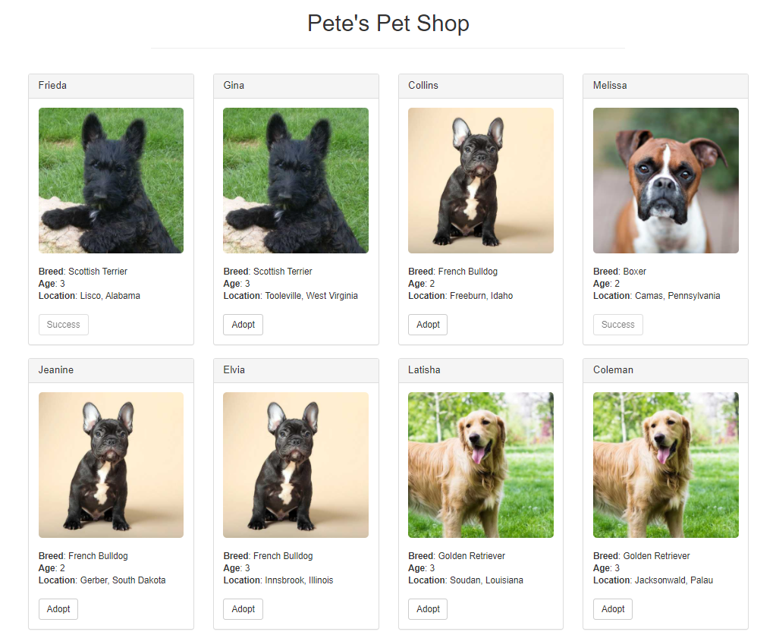
Final product looks…
User, just click to adopt a pet
Notes:
At first glance, it may seem that interleaving and overlapping represent fundamentally different modes of execution and present different problems. In fact, both techniques can be viewed as examples of concurrent processing, and both present the same problems. In the case of a uniprocessor, the problems stem from a basic characteristic of multiprogramming systems: The relative speed of execution of processes cannot be predicted. It depends on the activities of other processes, the way in which the OS handles interrupts, and the scheduling policies of the OS.

Slide 7
How to achieve this…?
Make a truffle project directory, download and unbox the boilerplate.
Modify/edit the relevant files, the most important = the .html (don’t worry, the steps will show this clearly)
Launch ganache locally, note the used port#
Deploy the SC
Connect all the components of the eco-system together : wallet (user’s), front-end & back-end.
Enjoy, watching all the backend transactions (etherscan)
Notes:
At first glance, it may seem that interleaving and overlapping represent fundamentally different modes of execution and present different problems. In fact, both techniques can be viewed as examples of concurrent processing, and both present the same problems. In the case of a uniprocessor, the problems stem from a basic characteristic of multiprogramming systems: The relative speed of execution of processes cannot be predicted. It depends on the activities of other processes, the way in which the OS handles interrupts, and the scheduling policies of the OS.

Slide 8
How to achieve this…?
BONUS-1 : Deploy your dApp from development to production, ie onto public TESTNET (x marks?)
BONUS-2 : Develop a mobile app on either android/iOS (y marks?)
Notes:
At first glance, it may seem that interleaving and overlapping represent fundamentally different modes of execution and present different problems. In fact, both techniques can be viewed as examples of concurrent processing, and both present the same problems. In the case of a uniprocessor, the problems stem from a basic characteristic of multiprogramming systems: The relative speed of execution of processes cannot be predicted. It depends on the activities of other processes, the way in which the OS handles interrupts, and the scheduling policies of the OS.

Slide 9

Let’s start…
If you are still struggling in the subject, you MUST run through and finish this tutorial …!
Notes:
At first glance, it may seem that interleaving and overlapping represent fundamentally different modes of execution and present different problems. In fact, both techniques can be viewed as examples of concurrent processing, and both present the same problems. In the case of a uniprocessor, the problems stem from a basic characteristic of multiprogramming systems: The relative speed of execution of processes cannot be predicted. It depends on the activities of other processes, the way in which the OS handles interrupts, and the scheduling policies of the OS.

Slide 10
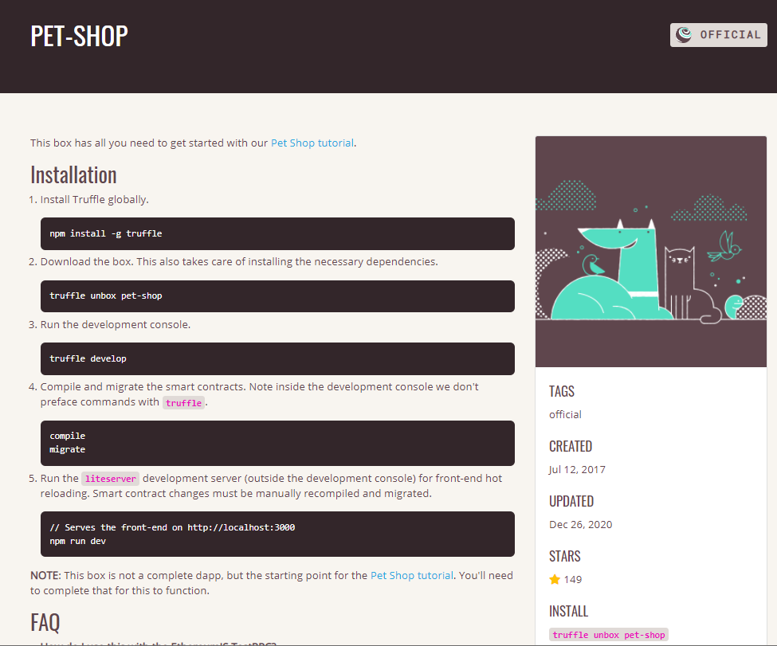
Step-1
Prepare the truffle project directory
Download the boilerplate from : http://trufflesuite.com/tutorials/pet-shop
Notes:
At first glance, it may seem that interleaving and overlapping represent fundamentally different modes of execution and present different problems. In fact, both techniques can be viewed as examples of concurrent processing, and both present the same problems. In the case of a uniprocessor, the problems stem from a basic characteristic of multiprogramming systems: The relative speed of execution of processes cannot be predicted. It depends on the activities of other processes, the way in which the OS handles interrupts, and the scheduling policies of the OS.

Slide 11
Step-2 to Step-4
Just follow the tutorial and :
Create a new SC, create your .js deployment file, ie (2_deploy_contract.js)
Launch your local blockchain (ganache)
Compile & migrate the SC
Note the port#
Maybe better done using ganache-gui.
Notes:
At first glance, it may seem that interleaving and overlapping represent fundamentally different modes of execution and present different problems. In fact, both techniques can be viewed as examples of concurrent processing, and both present the same problems. In the case of a uniprocessor, the problems stem from a basic characteristic of multiprogramming systems: The relative speed of execution of processes cannot be predicted. It depends on the activities of other processes, the way in which the OS handles interrupts, and the scheduling policies of the OS.

Slide 12
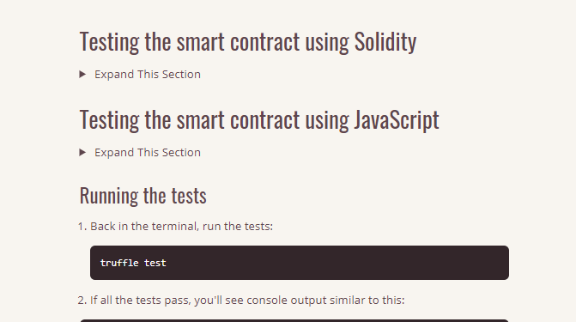
Note : for Project Part-2
The tutorial also shows how unit-testing is done on the SC.
This will be for Part-2 of the Project
Notes:
At first glance, it may seem that interleaving and overlapping represent fundamentally different modes of execution and present different problems. In fact, both techniques can be viewed as examples of concurrent processing, and both present the same problems. In the case of a uniprocessor, the problems stem from a basic characteristic of multiprogramming systems: The relative speed of execution of processes cannot be predicted. It depends on the activities of other processes, the way in which the OS handles interrupts, and the scheduling policies of the OS.

Slide 13
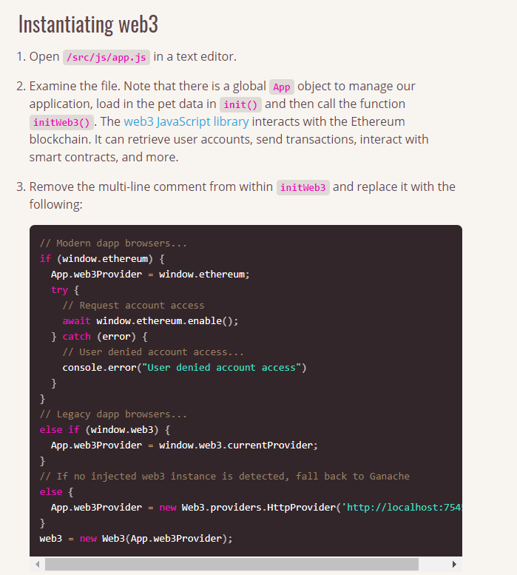
Step-5 to Step-6
Connect all the components of the eco-system together : wallet (user’s), front-end & back-end.
Notes:
At first glance, it may seem that interleaving and overlapping represent fundamentally different modes of execution and present different problems. In fact, both techniques can be viewed as examples of concurrent processing, and both present the same problems. In the case of a uniprocessor, the problems stem from a basic characteristic of multiprogramming systems: The relative speed of execution of processes cannot be predicted. It depends on the activities of other processes, the way in which the OS handles interrupts, and the scheduling policies of the OS.

Slide 14

Step-5 to Step-6
Note:
The tutorial also assumes installing metamask for the first time.
There has also been update to the metamask extension, so you should download the update too…
Notes:
At first glance, it may seem that interleaving and overlapping represent fundamentally different modes of execution and present different problems. In fact, both techniques can be viewed as examples of concurrent processing, and both present the same problems. In the case of a uniprocessor, the problems stem from a basic characteristic of multiprogramming systems: The relative speed of execution of processes cannot be predicted. It depends on the activities of other processes, the way in which the OS handles interrupts, and the scheduling policies of the OS.

Slide 15
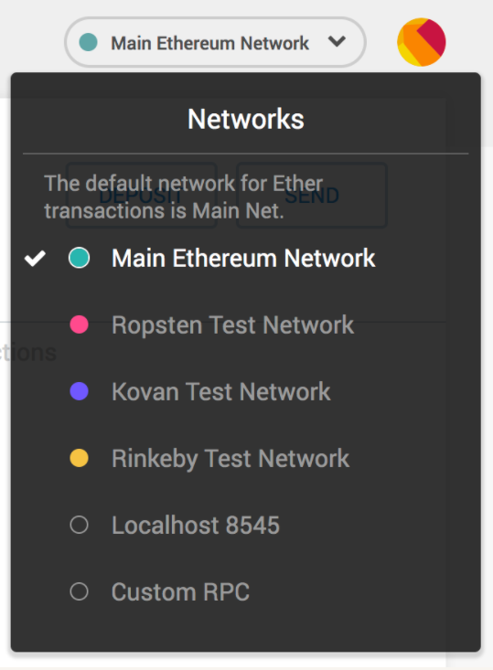
Step-5 to Step-6
Note: Customize the connection between the metamask and our local test blockchain
Notes:
At first glance, it may seem that interleaving and overlapping represent fundamentally different modes of execution and present different problems. In fact, both techniques can be viewed as examples of concurrent processing, and both present the same problems. In the case of a uniprocessor, the problems stem from a basic characteristic of multiprogramming systems: The relative speed of execution of processes cannot be predicted. It depends on the activities of other processes, the way in which the OS handles interrupts, and the scheduling policies of the OS.

Slide 16
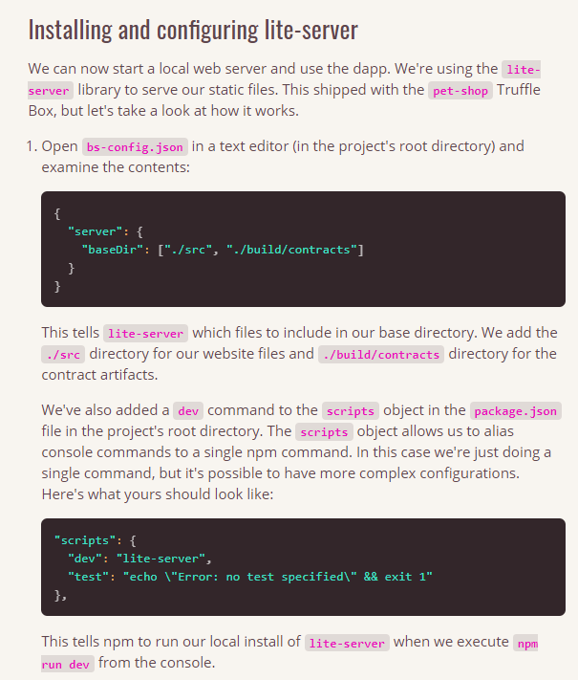
Step-5 to Step-6
Note : The pet-shop package comes with its own light static web server library called the lite-server
There are also a few other tricks, so modify the correct files in the project directory
Notes:
At first glance, it may seem that interleaving and overlapping represent fundamentally different modes of execution and present different problems. In fact, both techniques can be viewed as examples of concurrent processing, and both present the same problems. In the case of a uniprocessor, the problems stem from a basic characteristic of multiprogramming systems: The relative speed of execution of processes cannot be predicted. It depends on the activities of other processes, the way in which the OS handles interrupts, and the scheduling policies of the OS.

Slide 17
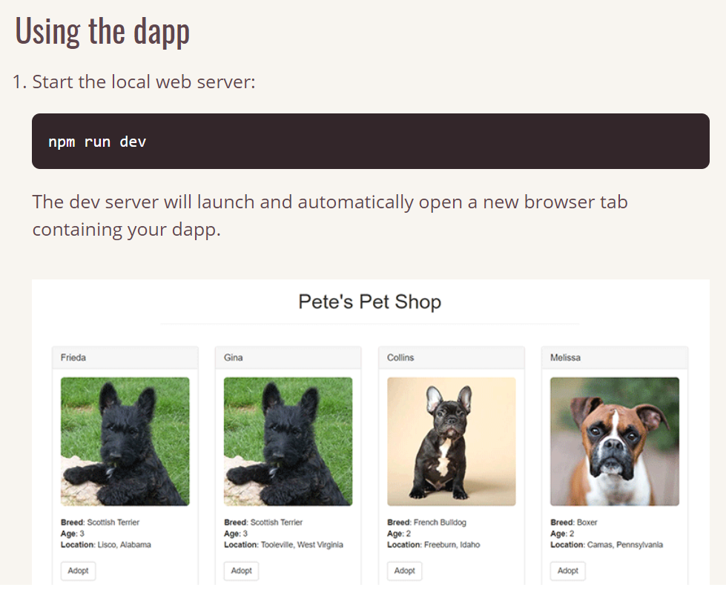
Step-5 to Step-6
Execute the dApp, and enjoy, watching all the backend transactions (metamask & etherscan)
Notes:
At first glance, it may seem that interleaving and overlapping represent fundamentally different modes of execution and present different problems. In fact, both techniques can be viewed as examples of concurrent processing, and both present the same problems. In the case of a uniprocessor, the problems stem from a basic characteristic of multiprogramming systems: The relative speed of execution of processes cannot be predicted. It depends on the activities of other processes, the way in which the OS handles interrupts, and the scheduling policies of the OS.

Slide 18
Share boiler plate you find
It is highly encouraged for you to share whatever boilerplate you manage to find online with others in the class…
Just share the “box” (boilerplate) and let every body customize it in his own way.
Notes:
At first glance, it may seem that interleaving and overlapping represent fundamentally different modes of execution and present different problems. In fact, both techniques can be viewed as examples of concurrent processing, and both present the same problems. In the case of a uniprocessor, the problems stem from a basic characteristic of multiprogramming systems: The relative speed of execution of processes cannot be predicted. It depends on the activities of other processes, the way in which the OS handles interrupts, and the scheduling policies of the OS.

Slide 19
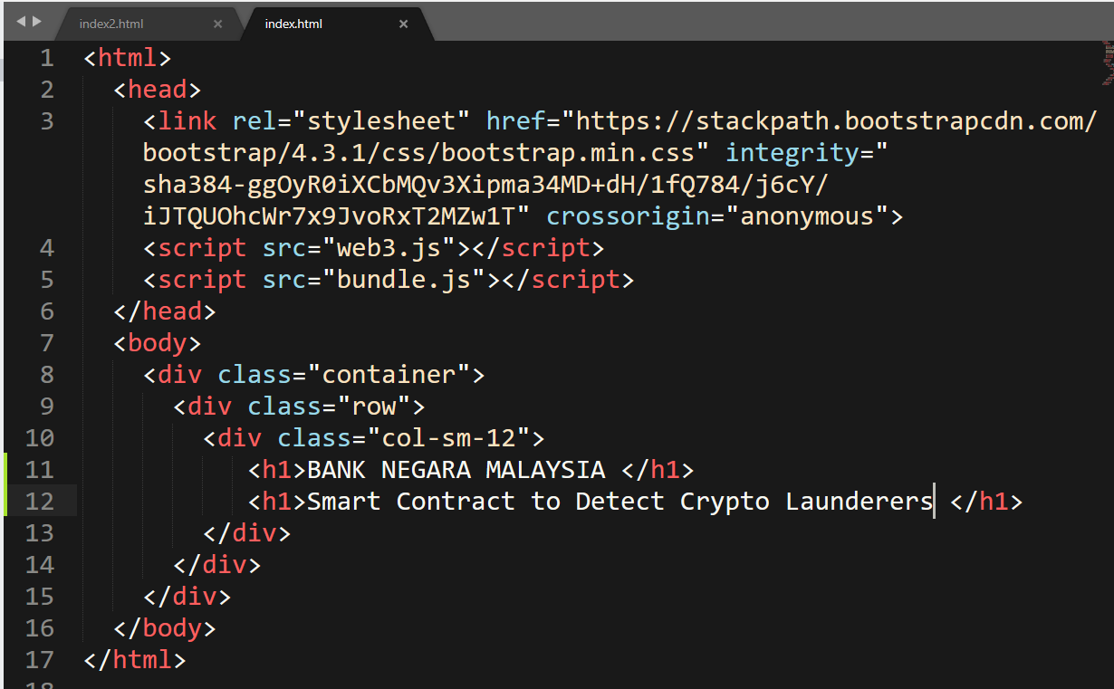
very naive html for Project
Just modify these lines, part of
the boiler plate
Notes:
At first glance, it may seem that interleaving and overlapping represent fundamentally different modes of execution and present different problems. In fact, both techniques can be viewed as examples of concurrent processing, and both present the same problems. In the case of a uniprocessor, the problems stem from a basic characteristic of multiprogramming systems: The relative speed of execution of processes cannot be predicted. It depends on the activities of other processes, the way in which the OS handles interrupts, and the scheduling policies of the OS.

Slide 20
End of this sub-topic
End of example of developing frontend
Notes:
At first glance, it may seem that interleaving and overlapping represent fundamentally different modes of execution and present different problems. In fact, both techniques can be viewed as examples of concurrent processing, and both present the same problems. In the case of a uniprocessor, the problems stem from a basic characteristic of multiprogramming systems: The relative speed of execution of processes cannot be predicted. It depends on the activities of other processes, the way in which the OS handles interrupts, and the scheduling policies of the OS.

